Slide 1
Toolbelt Psychology
Mike Place
SaltStack
mp@saltstack.com

Slide 2
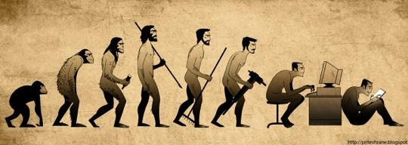
Tools: A Living History
Notes:
We can understand previous cultures and societies by the tools they used. Tells us how they approached problems.

Slide 3
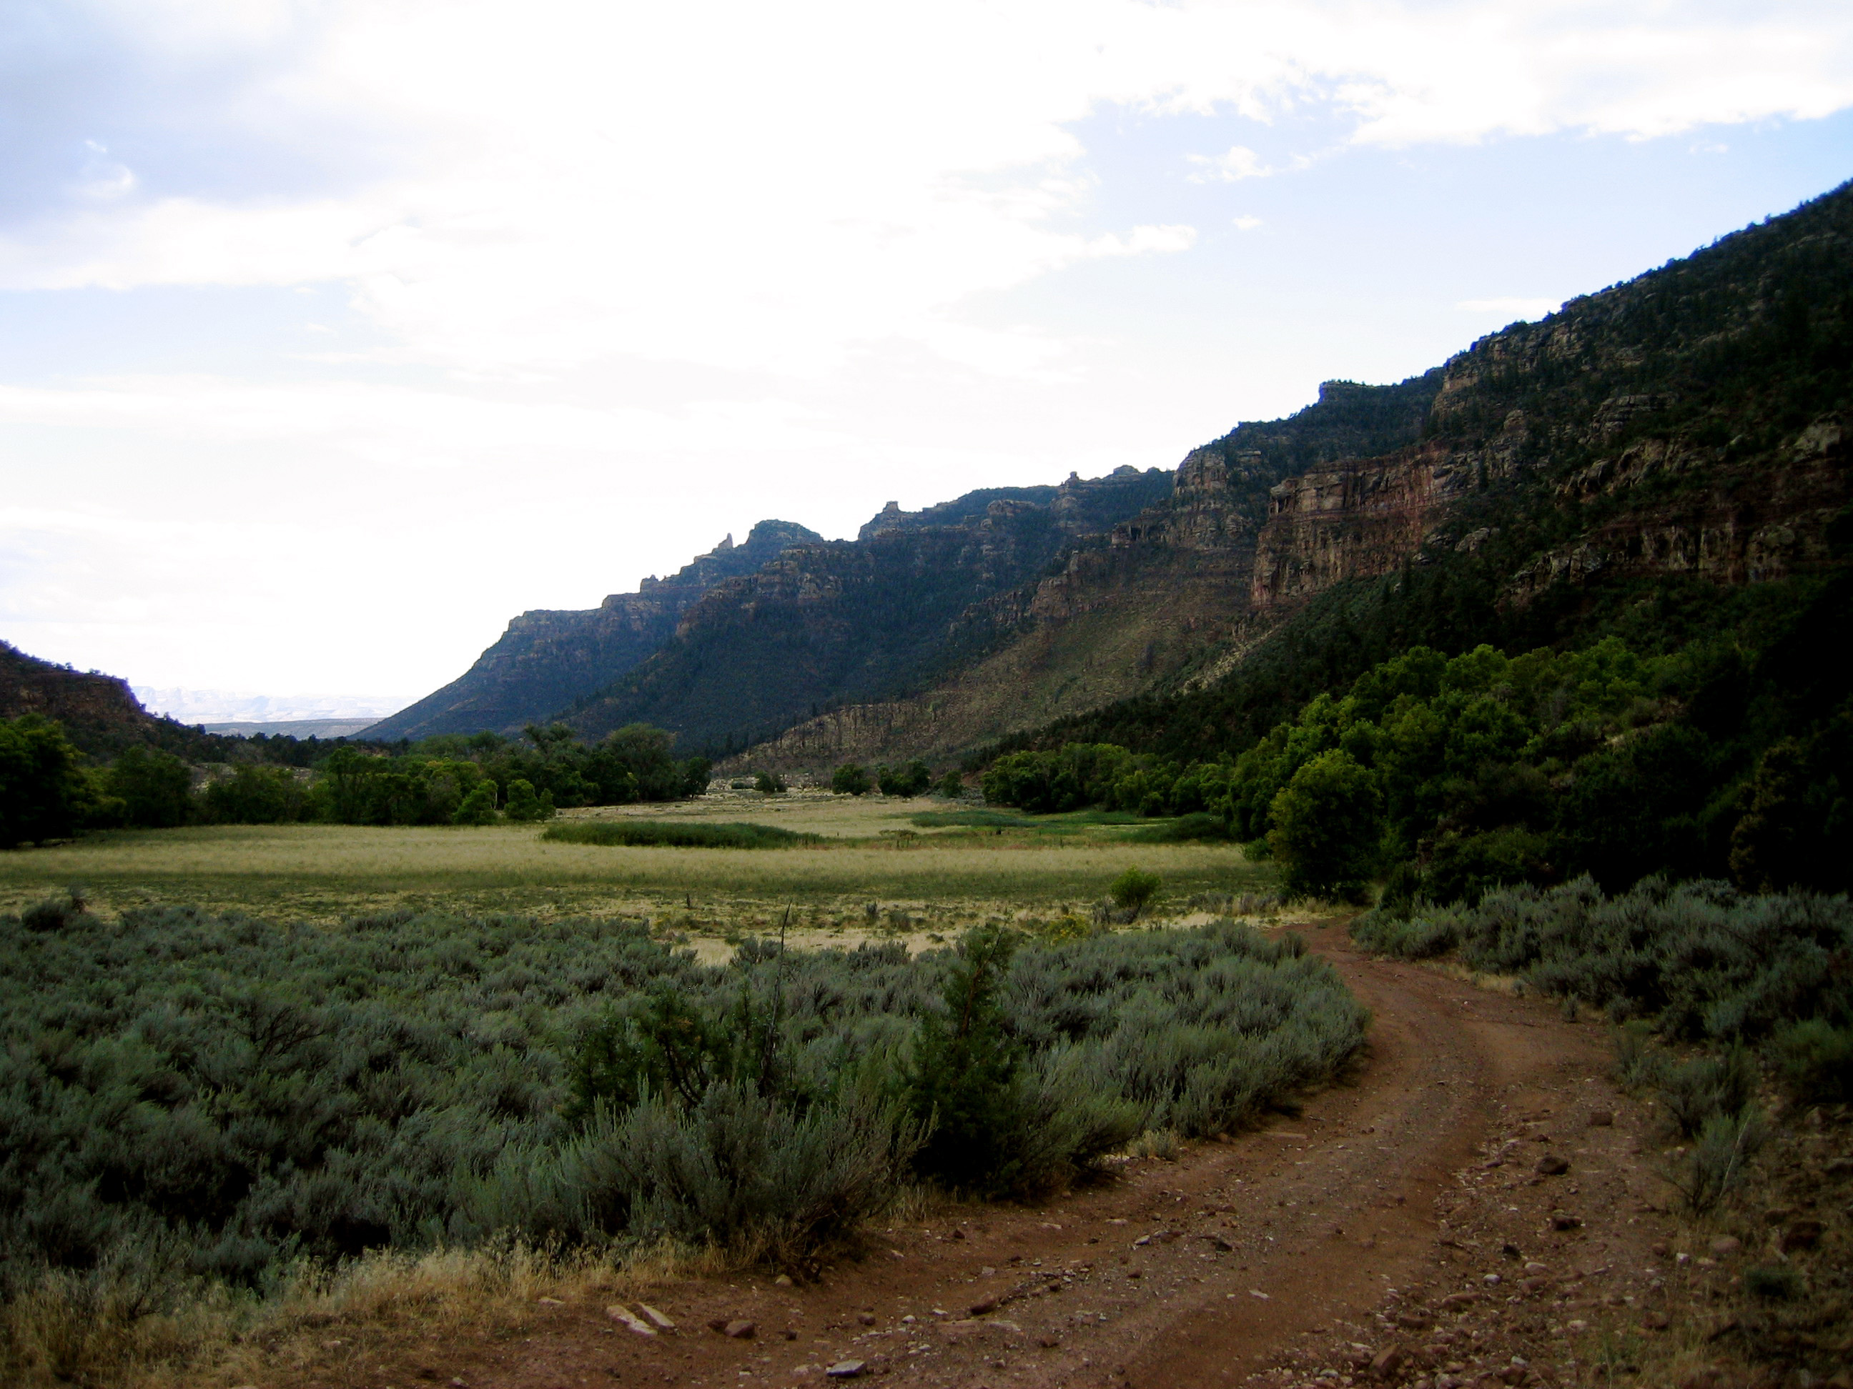
Notes:
Most of the sites are associated with the Fremont archaeological complex, a term used to describe Utah's earliest farmers who inhabited the region from about A.D. 300 - A.D. 1350.

Slide 4
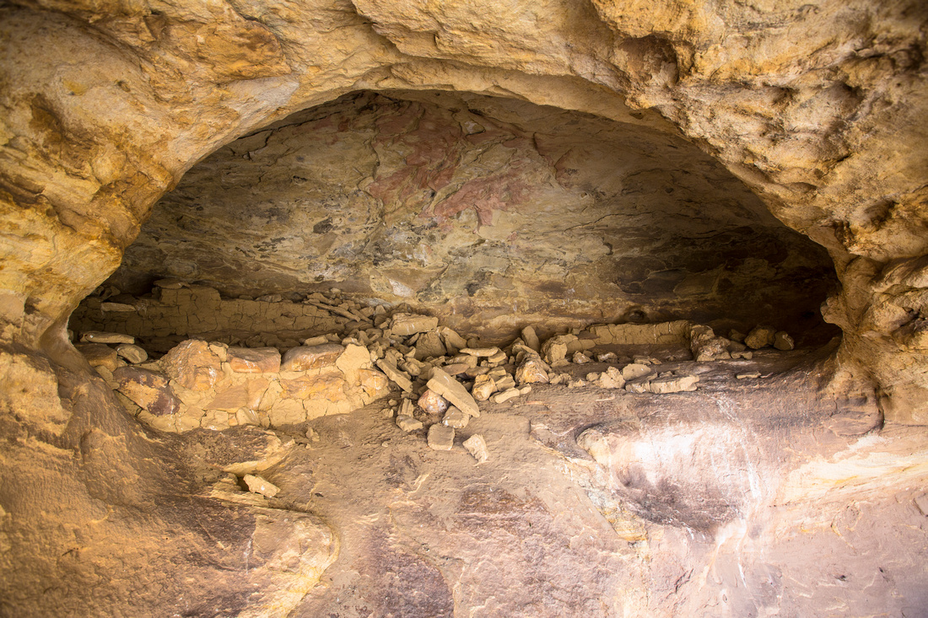

Slide 5
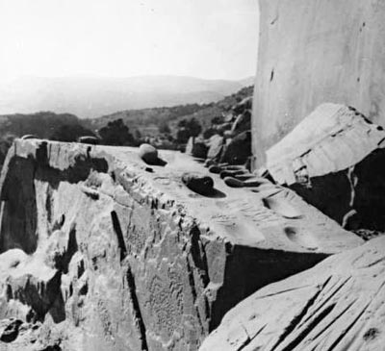

Slide 6
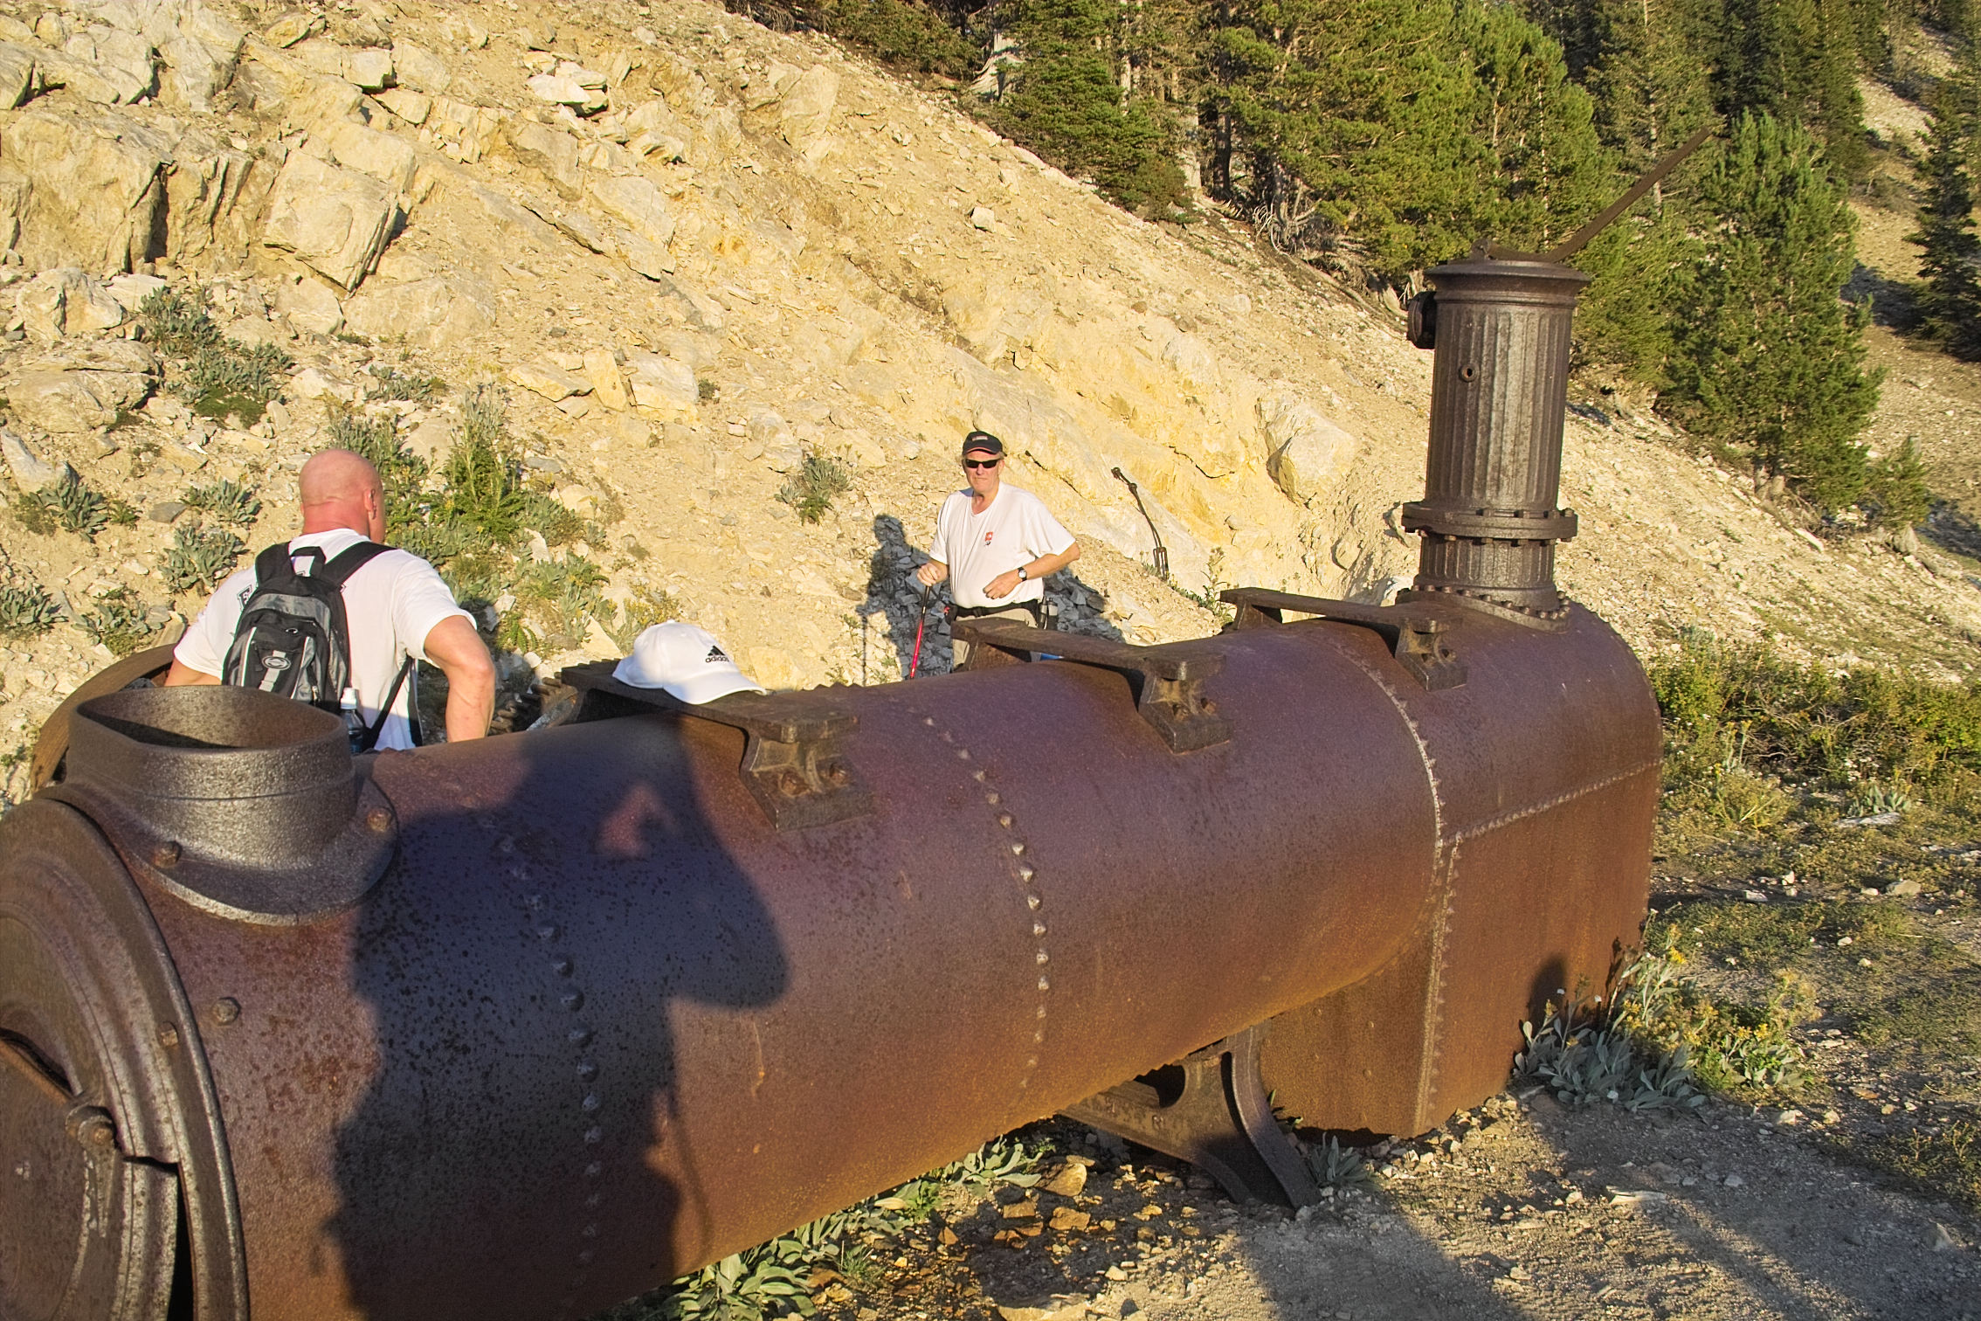

Slide 7

Tools
When we examine the history of an era, we too often restrict ourselves to the things that we built.
To understand a history, we need to both look at the tools that were used to make them. (Sometimes they even outlast what they built!)

Slide 8
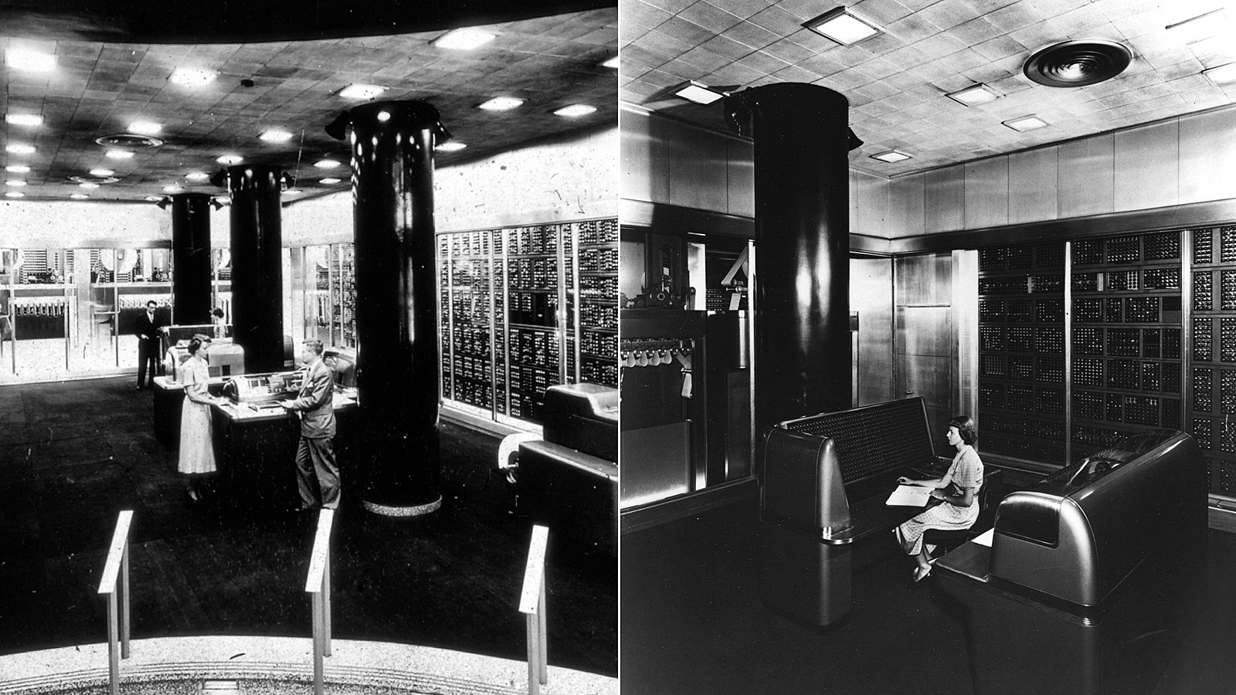
Notes:
IBM´s Selective Sequence Electronic Calculator produced the moon-position tables used for plotting the course of the 1969 Apollo trip to the moon.

Slide 9
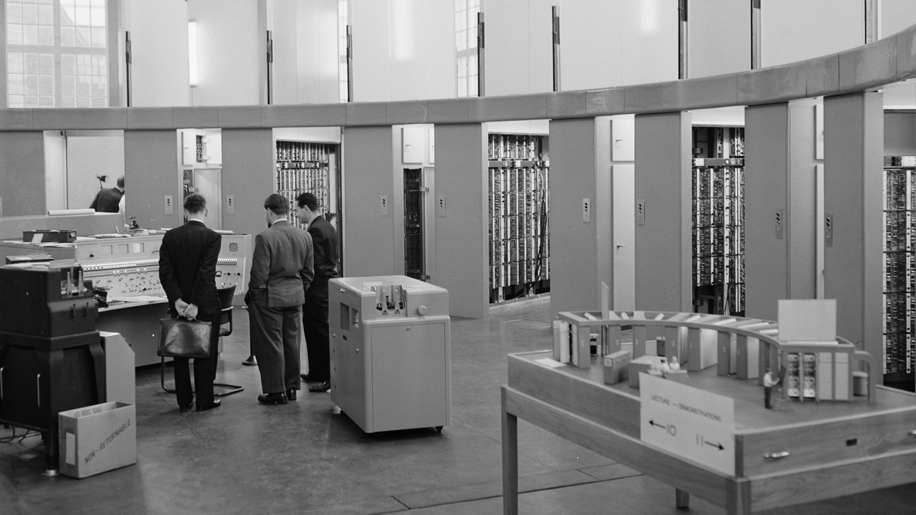
Notes:
Setups like the Automatic Computing Engine, shown here at an international computing symposium in London in November, 1958, proved that the computer rooms could be architectural achievements as well.

Slide 10
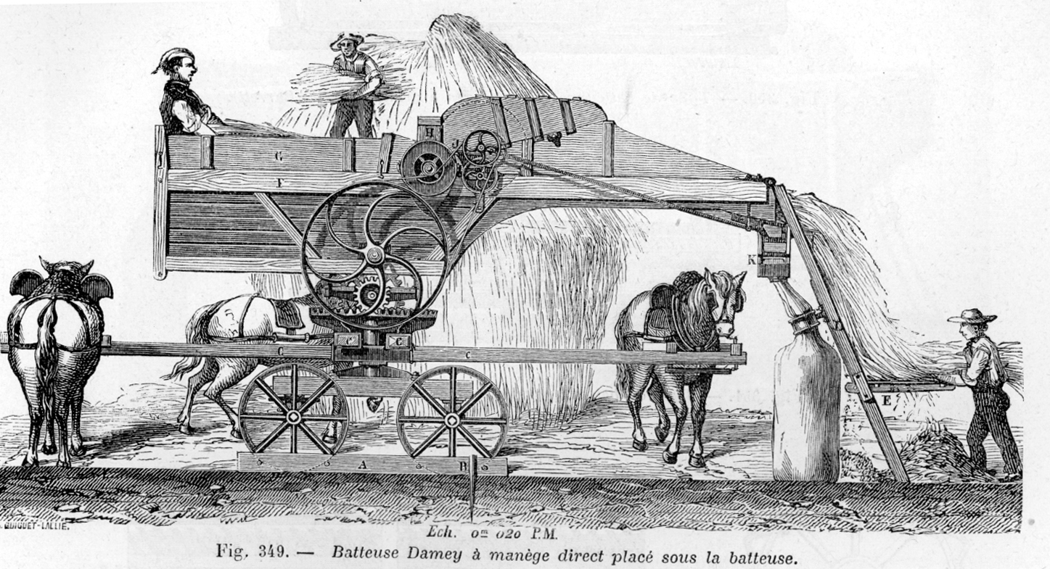

Automate!
works
solution
sales
social
contact
What improves?
Speed: The ability to produce more in less time
Reliability: The ability to produce goods at a consistent rate.
Quality: The ability to standardize on a given form and ensure that form is easily reproducable.
Cost: The ability to lower the cost of each unit produced.
Other works
8
ole
Notes:
Threshing machine from 1881. Steam engines were also used instead of horses. Today both threshing and reaping are done with a combine harvester. Used to seperate wheat from chaff.

Slide 11

Automate!
works
solution
sales
social
contact
What does not improve?
Abstraction: Can be a positive but also a negative. Understanding of lower layers could decrease.
Craftsmenship: When we automate, we
Safety: Automation makes it exceedingly easy to destroy everything.
Other works
8
ole
Notes:
Threshing machine from 1881. Steam engines were also used instead of horses. Today both threshing and reaping are done with a combine harvester. Used to seperate wheat from chaff.

Slide 12
DON'T

Slide 13
AUTOMATE

Slide 14
WHAT

Slide 15
YOU

Slide 16
DON'T

Slide 17
UNDERSTAND

Slide 18


Slide 19
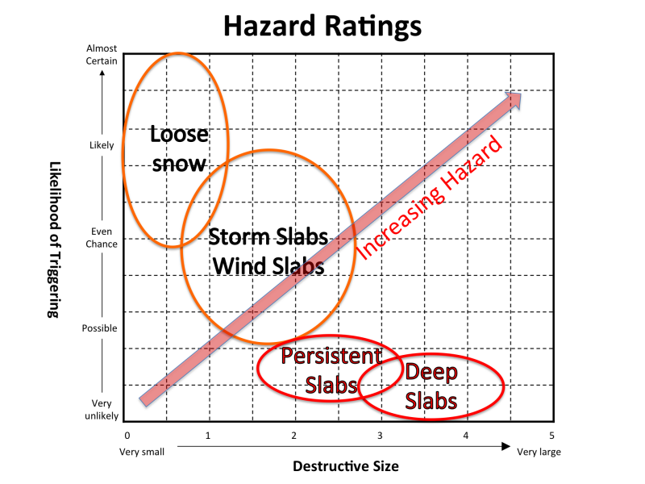
Probability and Consequences
What is the problem we are trying to solve?
Notes:
Systems management is the art of managing the relationship between probability and consequences.
Explain avalanche safety.

Slide 20


Slide 21
Write programs that do one thing and do it well.
Write programs that work together.
Write programs to handle text streams, because that is a universal interface.
Notes:
Interestingly, the UNIX philosophy is one of the places where we started to socialize the idea that we could have "tools". To wit:

Slide 22
UNIX Program Design
“Much of the power of the UNIX operating system comes from a style of program design that makes programs easy to use and, more important, easy to combine with other programs. This style has been called the use of software tools, and depends more on how the programs fit into the programming environment and how they can be used with other programs than on how they are designed internally. [...] This style was based on the use of tools: using programs separately or in combination to get a job done, rather than doing it by hand, by monolithic self-sufficient subsystems, or by special-purpose, one-time programs.”
Brian Kerighan and Rob Pike, "Program Design in the UNIX Environment"
Notes:
Interestingly, the UNIX philosophy is one of the places where we started to socialize the idea that we could have "tools". To wit:

Slide 23
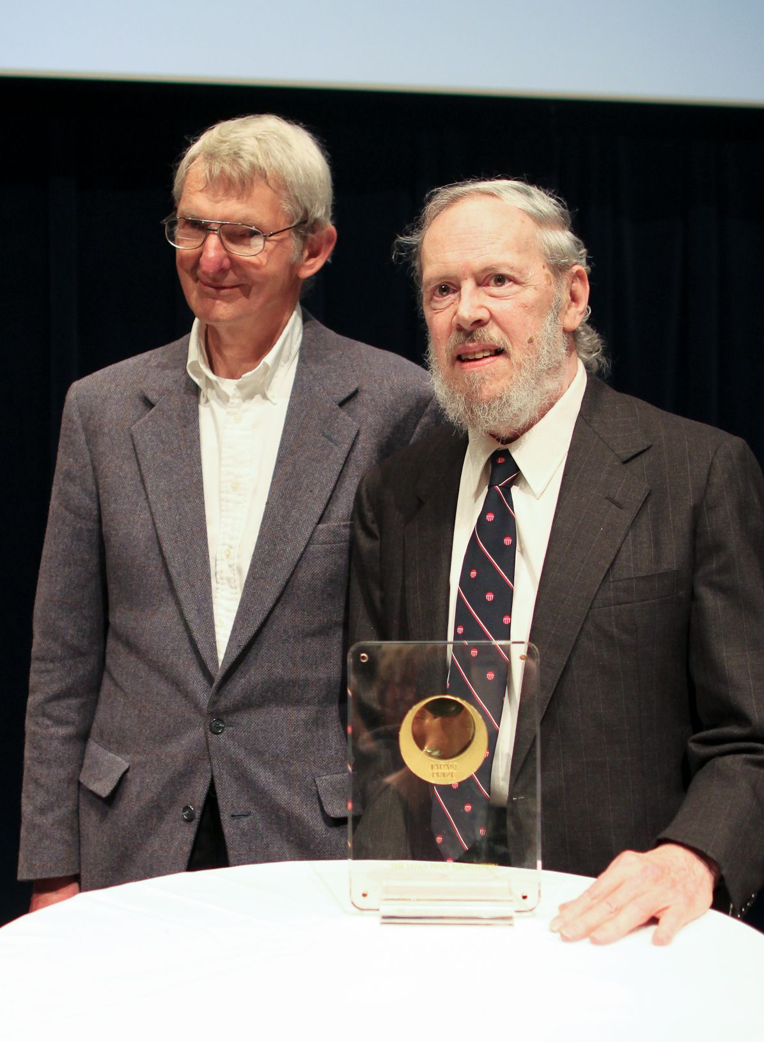
UNIX Program Design
“As a programmer, it is your job to put yourself out of business. What you do today can be automated tomorrow.”
Doug McIlroy, invented the UNIX pipe
Notes:
b. "The notion of "intricate and beautiful complexities" is almost an oxymoron. Unix programmers vie with each other for "simple and beautiful" honors — a point that's implicit in these rules, but is well worth making overt."
c. He has criticized Linux for being bloated as compared to his UNIX designs when he was at Bell Labs:
"Everything was small... and my heart sinks for Linux when I see the size of it. [...] The manual page, which really used to be a manual page, is now a small volume, with a thousand options... We used to sit around in the Unix Room saying, 'What can we throw out? Why is there this option?' It's often because there is some deficiency in the basic design — you didn't really hit the right design point. Instead of adding an option, think about what was forcing you to add that option."

Slide 24

In the Beginning...
There were no differences between "dev" and "ops" because there was only one.
-John Allspaw (Etsy)

Slide 25

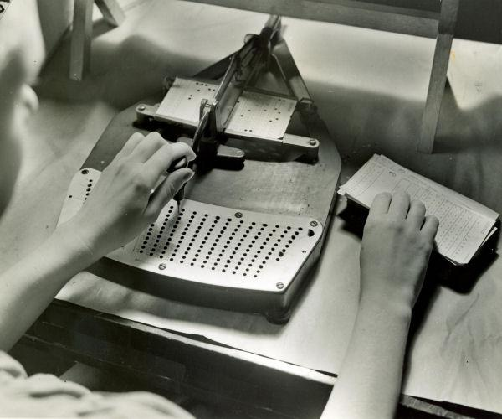
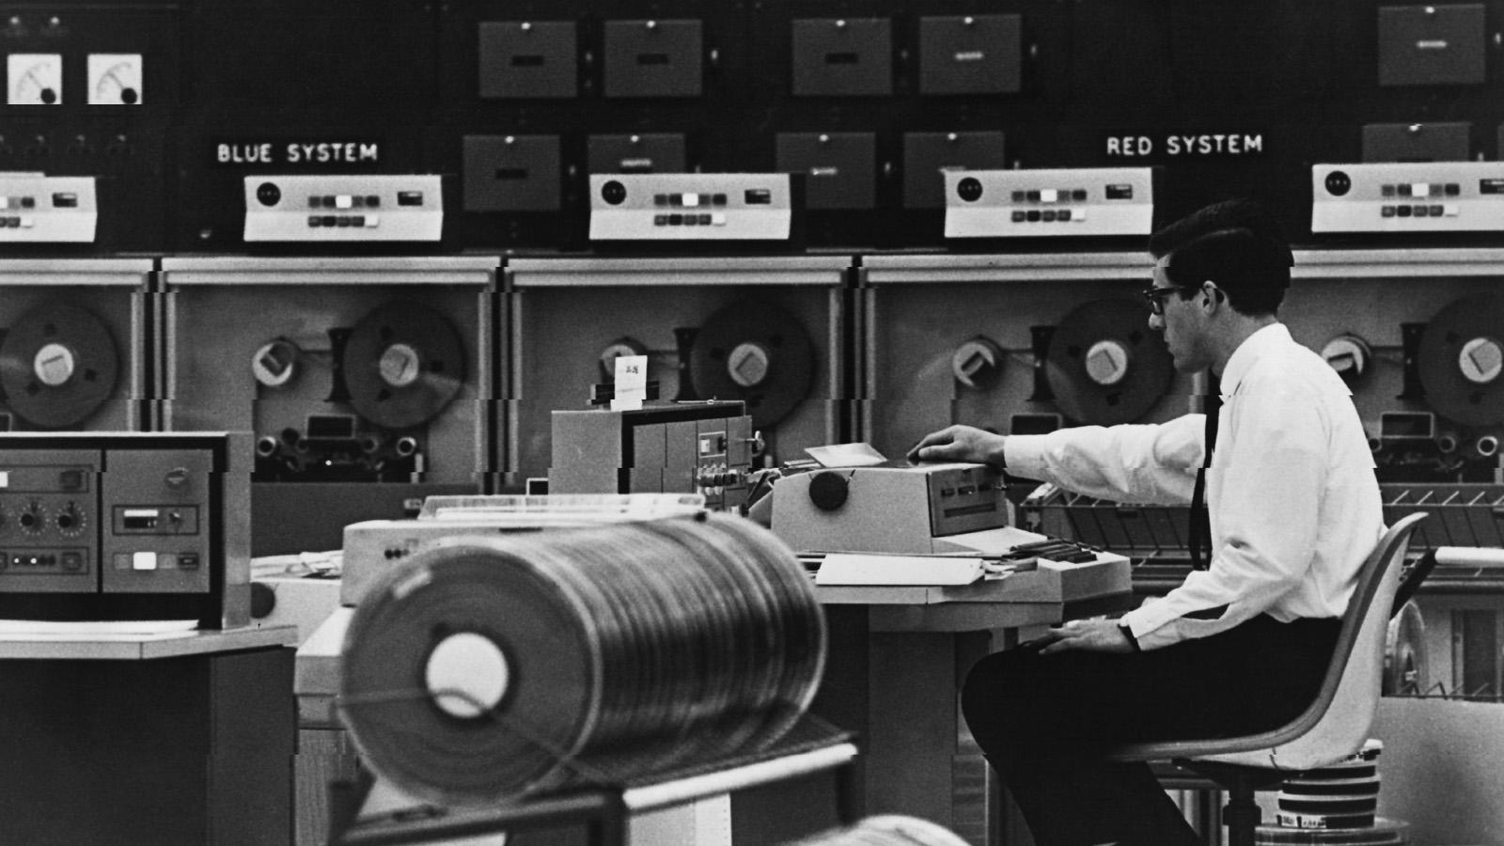
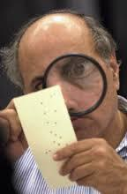
Then Ops Happened!
Notes:
b. Then programmers started writing punch cards and operators ran around changing tapes around and fixing things when they broke. (Which was often!)
c. Then we had the microcomputer and suddenly, we could build servers for lots of different things (not too many, though) and those all needed to be
maintained.

Slide 26







A Problem of Scale
Humans don't virtualize quite as well as machines do.
Virtualization
Virtualization
DOES NOT
COMPUTE
Notes:
d. Then as virtualization started to emerge, the scale of the number of "machines" that a sysadmins had to manage ballooned along with it.
* Sysadmins didn't scale.
e. So what ends up happening here is that modern applications have traditional needs (fault tolorance, uptime, etc) but those needs have melded back into the application.
f. So DevOps takes Dev/Ops/QA and tries to connect them through software.
* Is solving cultural problems with technology a good idea? Maybe.

Slide 27
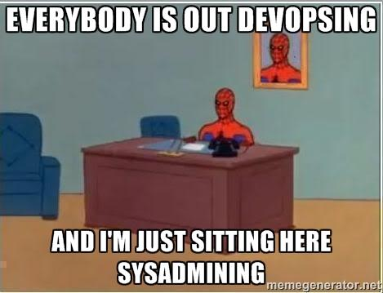
Complexity Moves
Creating modern DevOps
Complexity
Notes:
Now let's do a brief history of devops and configuration management and analyze where we are today.

Slide 28
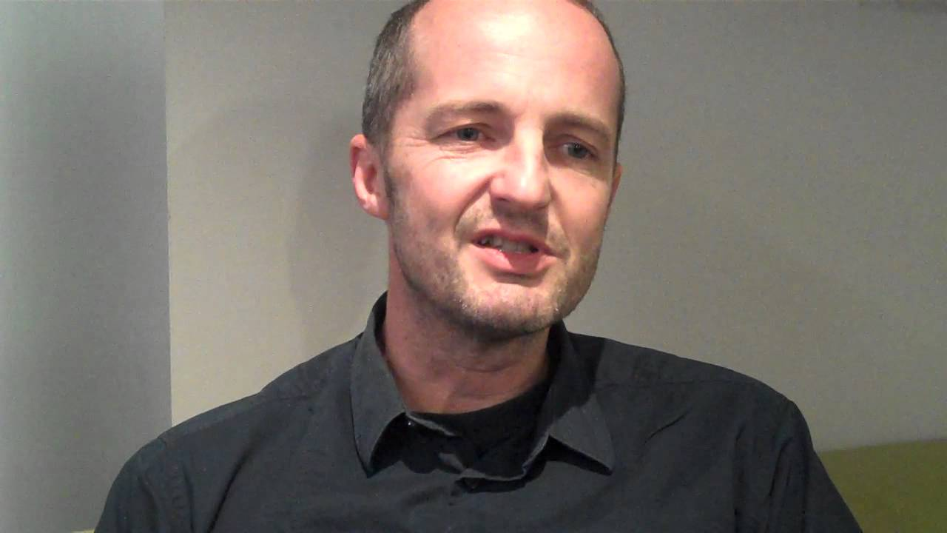
“We also use [that] limitation purposely as a tool to understand things, to form the illusion of mastery and control over a limited scale of things, because by being able to isolate only a part of the world, we reduce a hopeless problem to a manageable one.”
― Mark Burgess, In Search of Certainty: The Science of Our Information Infrastructure

Slide 29
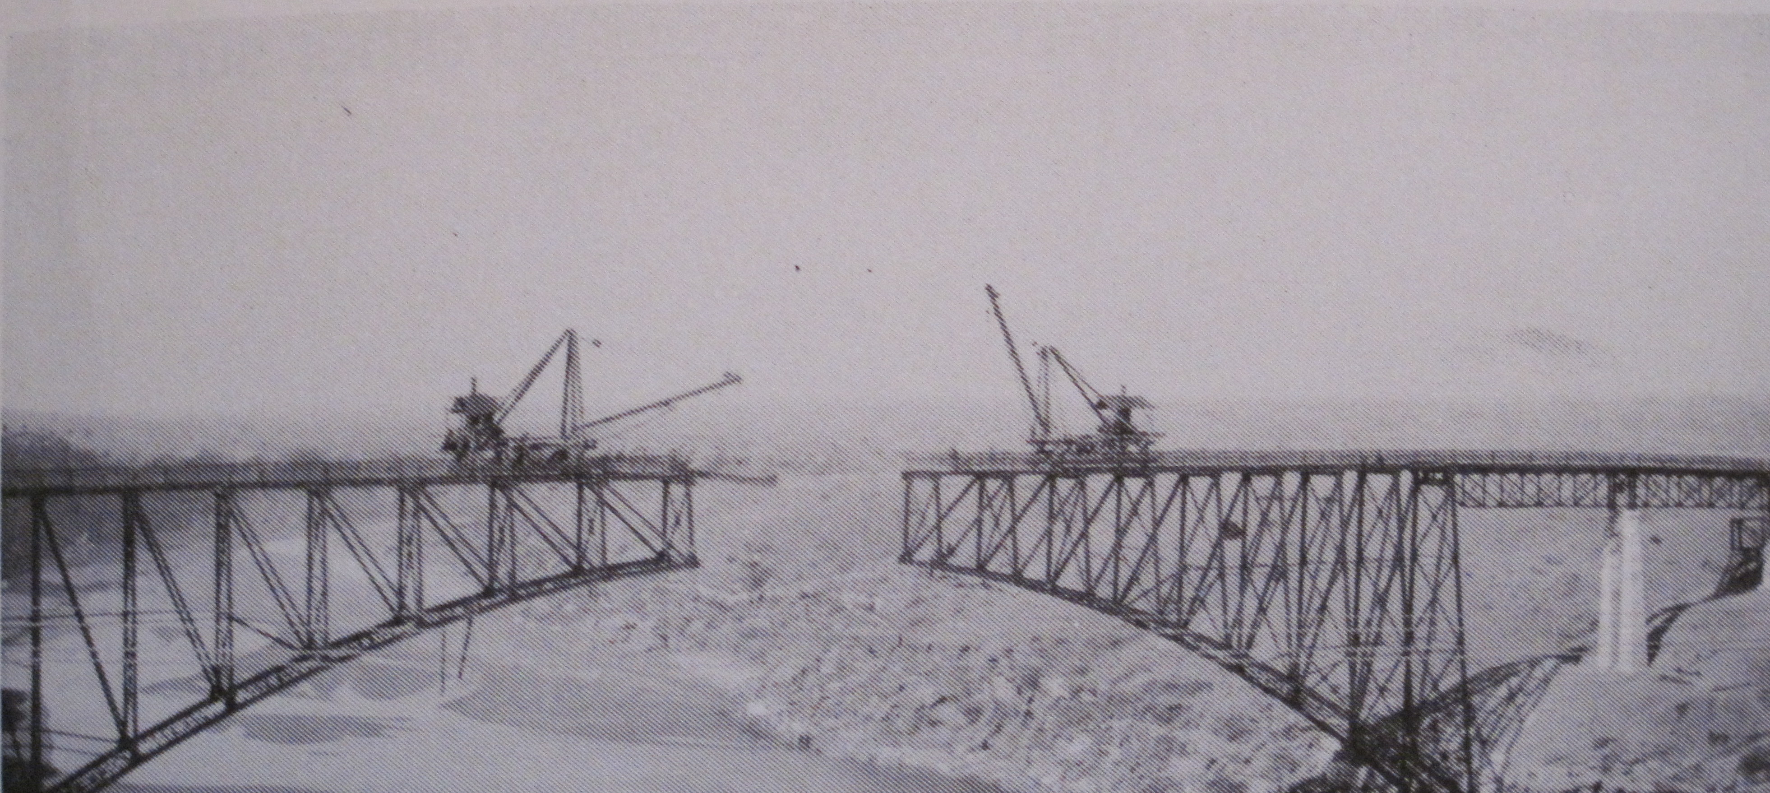
Notes:
People are fond of saying that devops isn't a team or a technology but that it's a culture, but there are a set of tools that have arisen around that culture. Why is that? Look at the tools that are being used and let's examine what problems they reflect on in the devops movement?

Slide 30
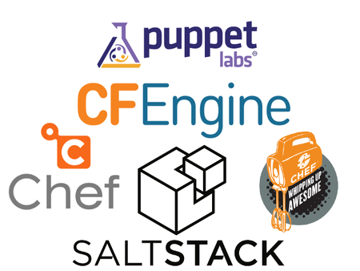


Slide 31
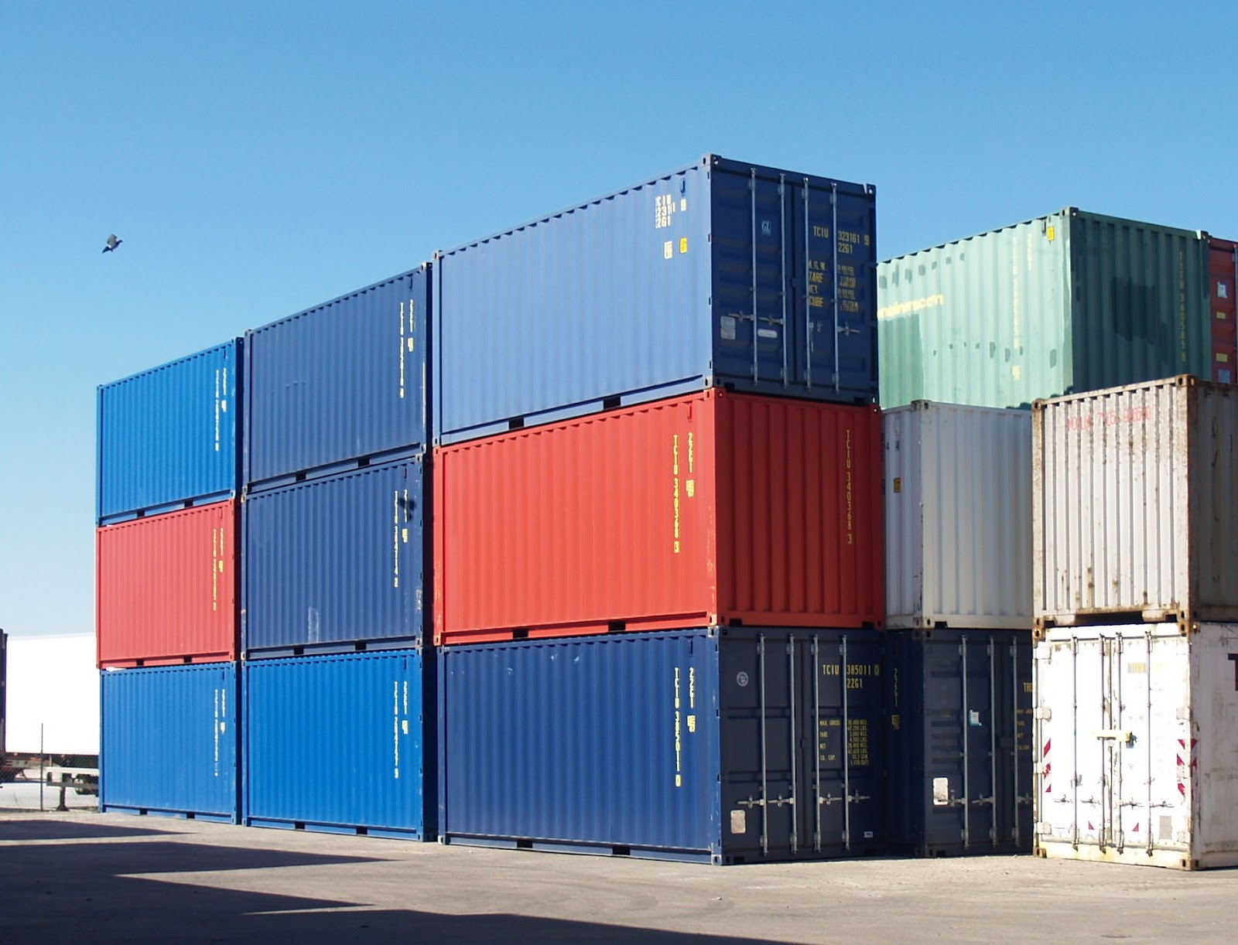
Notes:
Containers!
Of course containers are not new. . LXC (2008). (Solaris 10, 2004). FreeBSD 4.0 Jails (2000), BSD chroot (1982).
(Config Manament, and system management now starting to divide around deploy management vs. life-cycle management)
So the question becomes, is it the tool itself or the timeperiod. Why are containers suddenly popular?

Slide 32


Slide 33
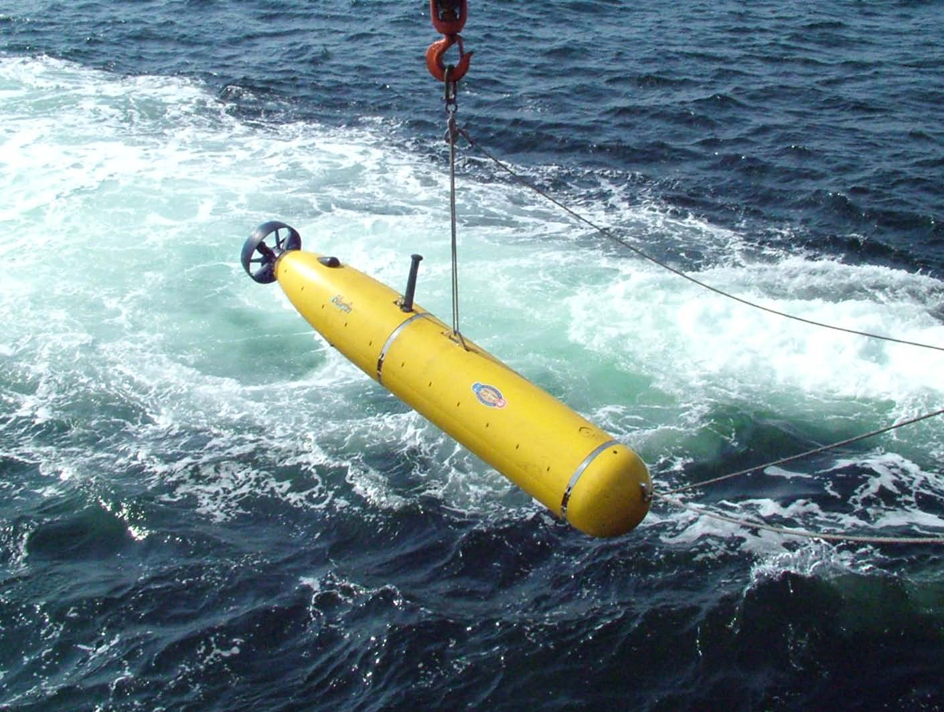

Slide 34


Slide 35
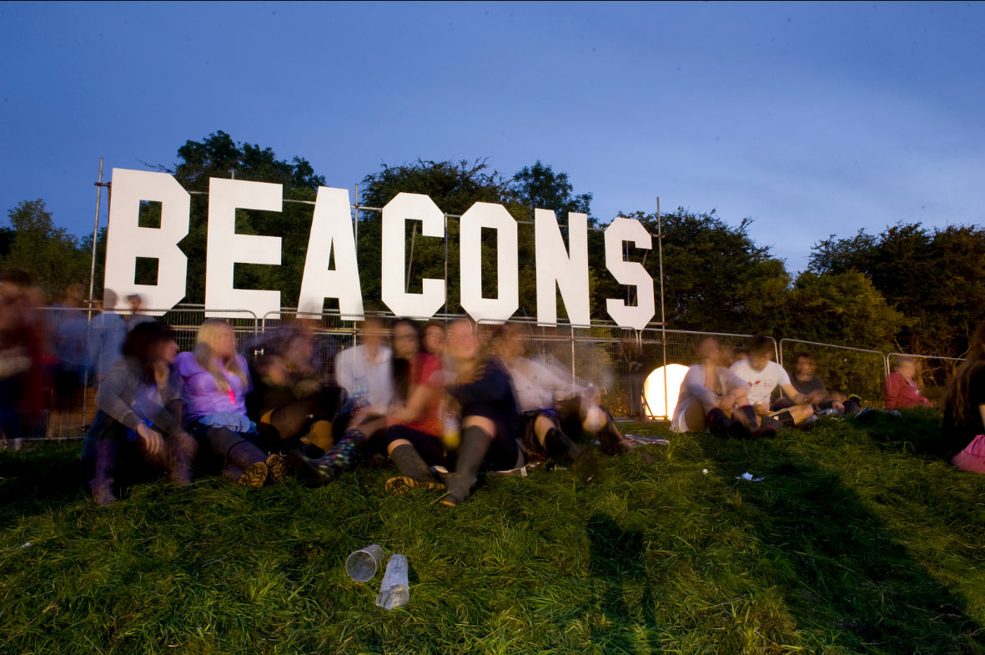

Slide 36
3 Questions to Ask Ourselves

Slide 37
1. How can we understand the problems that we are trying to solve by examining the tools which we use to solve them?

Slide 38
2. Can automation decrease complexity or can it only increase efficiency?

Slide 39
3. Are we using automation to augment our understanding or as a substitute for failing to understand?

Slide 40
Thanks.
Questions?

